Slide 1

EXCEL RE ASSESSMENT
SHAKTIVEL R-4308

Slide 2
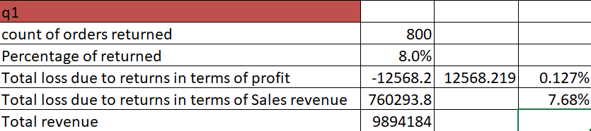
Q1
INFERENCE
The count of orders returned is 800
The percentage is 8from total orders
The total loss is -12568
FORMULA USED
COUNTIF(Orders!V2:V9995,"Yes")
ABS(SUMIFS(Orders!U2:U9995,Orders!U2:U9995,"<0",Orders!V2:V9995,"Yes"))
SUMIF(Orders!V2:V9995,"Yes",Orders!Y2:Y9995)
INSIGHTS:
The return rate is directly impacting on the profit of the sales
So the returns must be reduced by taking necessary actions

Slide 3
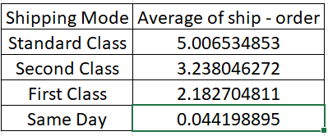
Q2
INSIGHTS
The shipping mode has less percentage
in same day which shows that on same day shipping is less
And in standard class the shipping rate is
high which shows many orders are placed in standard class
INFERENCE
The fastest delivery time is on the same day
The slowest delivery time is on the standard class

Slide 4
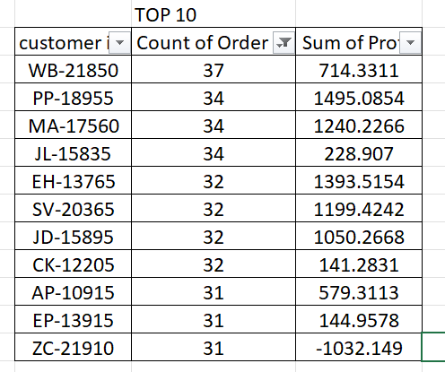
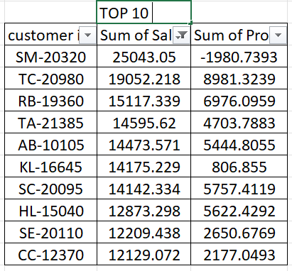
Q3
INFERENCE and insights
In customer relationship
Bw the counts of order
The profit is maximum
In customer id relationship with
Sales amt the profit is oscillating
According to sum of sales values
from descending order
Therefore the customer with frequency contributes to more profit .

Slide 5

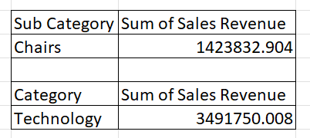

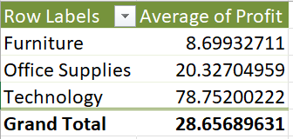
Q4
INFERENCE
TOP SELLING CATEGORY IN SALES :
TECHNOLOGY
TOP SELLING CATEGORY IN REVENUE :
TECHNOLOGY
TOP SELLING SUB CATEGORY IN SALES :PHONES
TOP SELLING SUB CATEGORY IN REVENUE : CHAIRS
Row Labels | Average of Profit
Accessories | 54.111788
Appliances | 38.92275837
Art | 8.200737437
Binders | 19.84357406
Bookcases | -15.23050877
Chairs | 43.09589352
Copiers | 817.9091897
Envelopes | 27.4180185
Fasteners | 4.375659908
Furnishings | 13.64591808
Labels | 15.23696154
Machines | 29.4326687
Paper | 24.85661993
Phones | 50.07393768
Storage | 25.15227707
Supplies | -6.258418421
Tables | -55.56577147
Grand Total | 28.65689631
INSIGHTS :
From the result (avg profit rate)
And average profit contribution
We can come to know that what are the products
That needed to be concentrated more in each category and sub category so that the profit can be increased

Slide 6
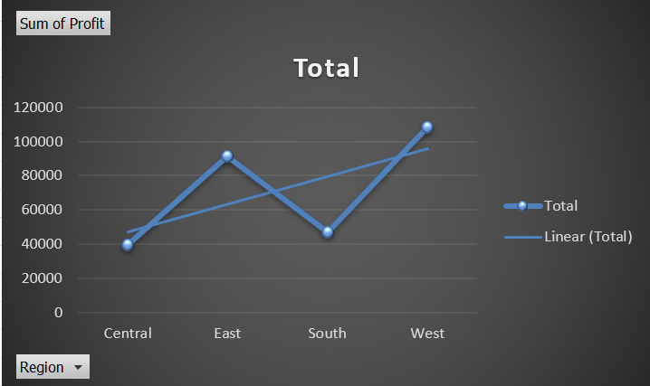
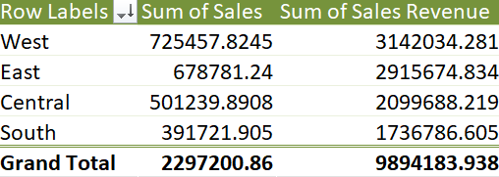
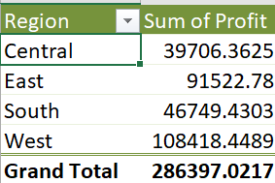
Q5
Inference:
Highest sales region :WEST
Highest sales revenue region:CENTRAL
INSIGHTS:
From the graph we can infer that
There’s a increase and decreasing pattern in diff regions
Its low in central and south
Where as max in east and west

Slide 7

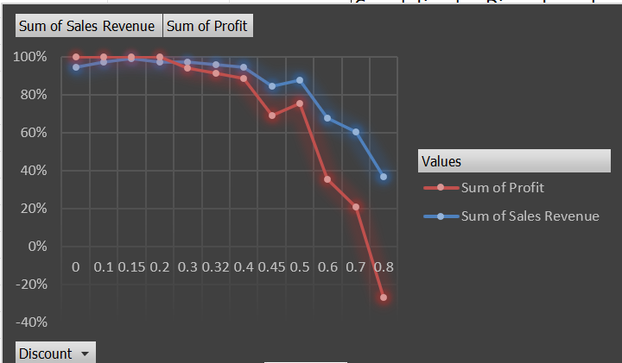
Q6
INFERENCE and insights :
The correlation bw disc rate and qty shows that both are not that much related.NO correlation since correlation coeff is near to zero
Correlation bw disc rate and profit
Shows negative correlation which means as disc increases profit decreases .
In graph the negative relation is shown with respect to disc rates

Slide 8
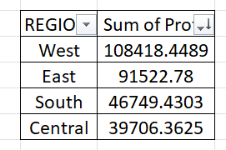
Q7
INFERENCE:
In the table we can find the order of region with
Sum of profits contributed
In descending order that’s max to min
INSIGHTS:
Since WEST has high profit it has low saturation and high market potential
And also CENTRAL has low profit
It also has low saturation and high market potential so that
More customers can be attracted from these areas.

Slide 9
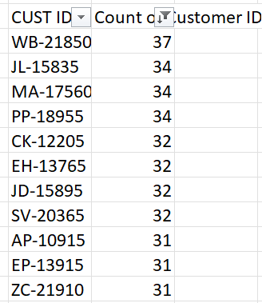
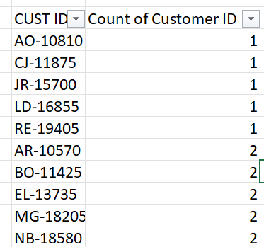
Q8
INFERENCE:
The first table shows thehigh frequency of customer giving orders
The second table shows the low frequency of customer orderings.
INSIGHTS :
From the table given we can find the customer retention rate
We can focus more on the low frequent customers
So as to increase profit .

Slide 10
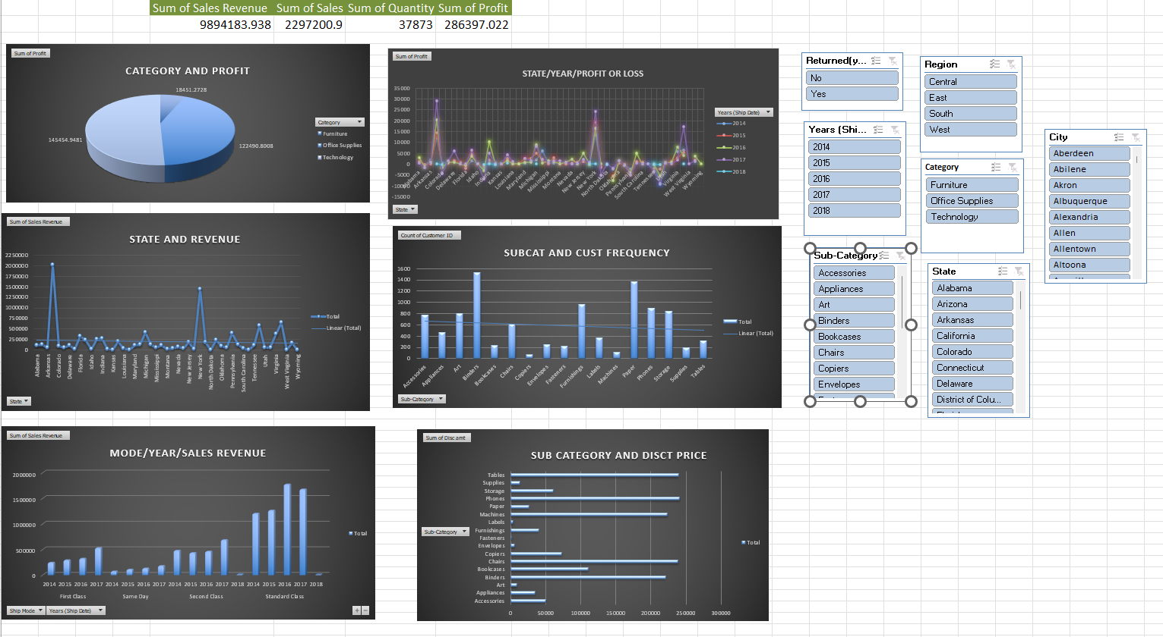
DASH BOARD-Q9

